Slide 1
SIM GAME
Minh Nguyen, hau ha

Slide 2
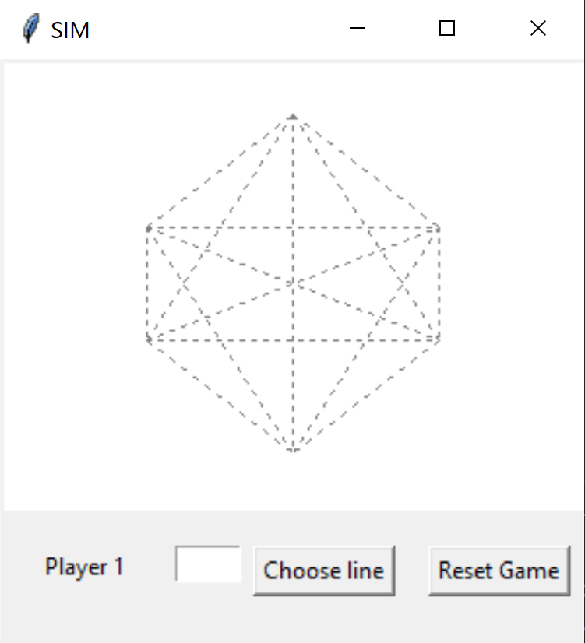
OVERVIEW
Zero Sum game
Two players take turn take turns coloring any uncolored lines (15 possible lines)
One player colors in one color, and the other colors in another color
The goal is to avoid drawing a triangle
Only triangles with the dots as corners count, intersections of lines are not relevant
Player who completes a triangle loses immediately
Each line is labeled with a letter from ‘a’ to ‘o’

Slide 3
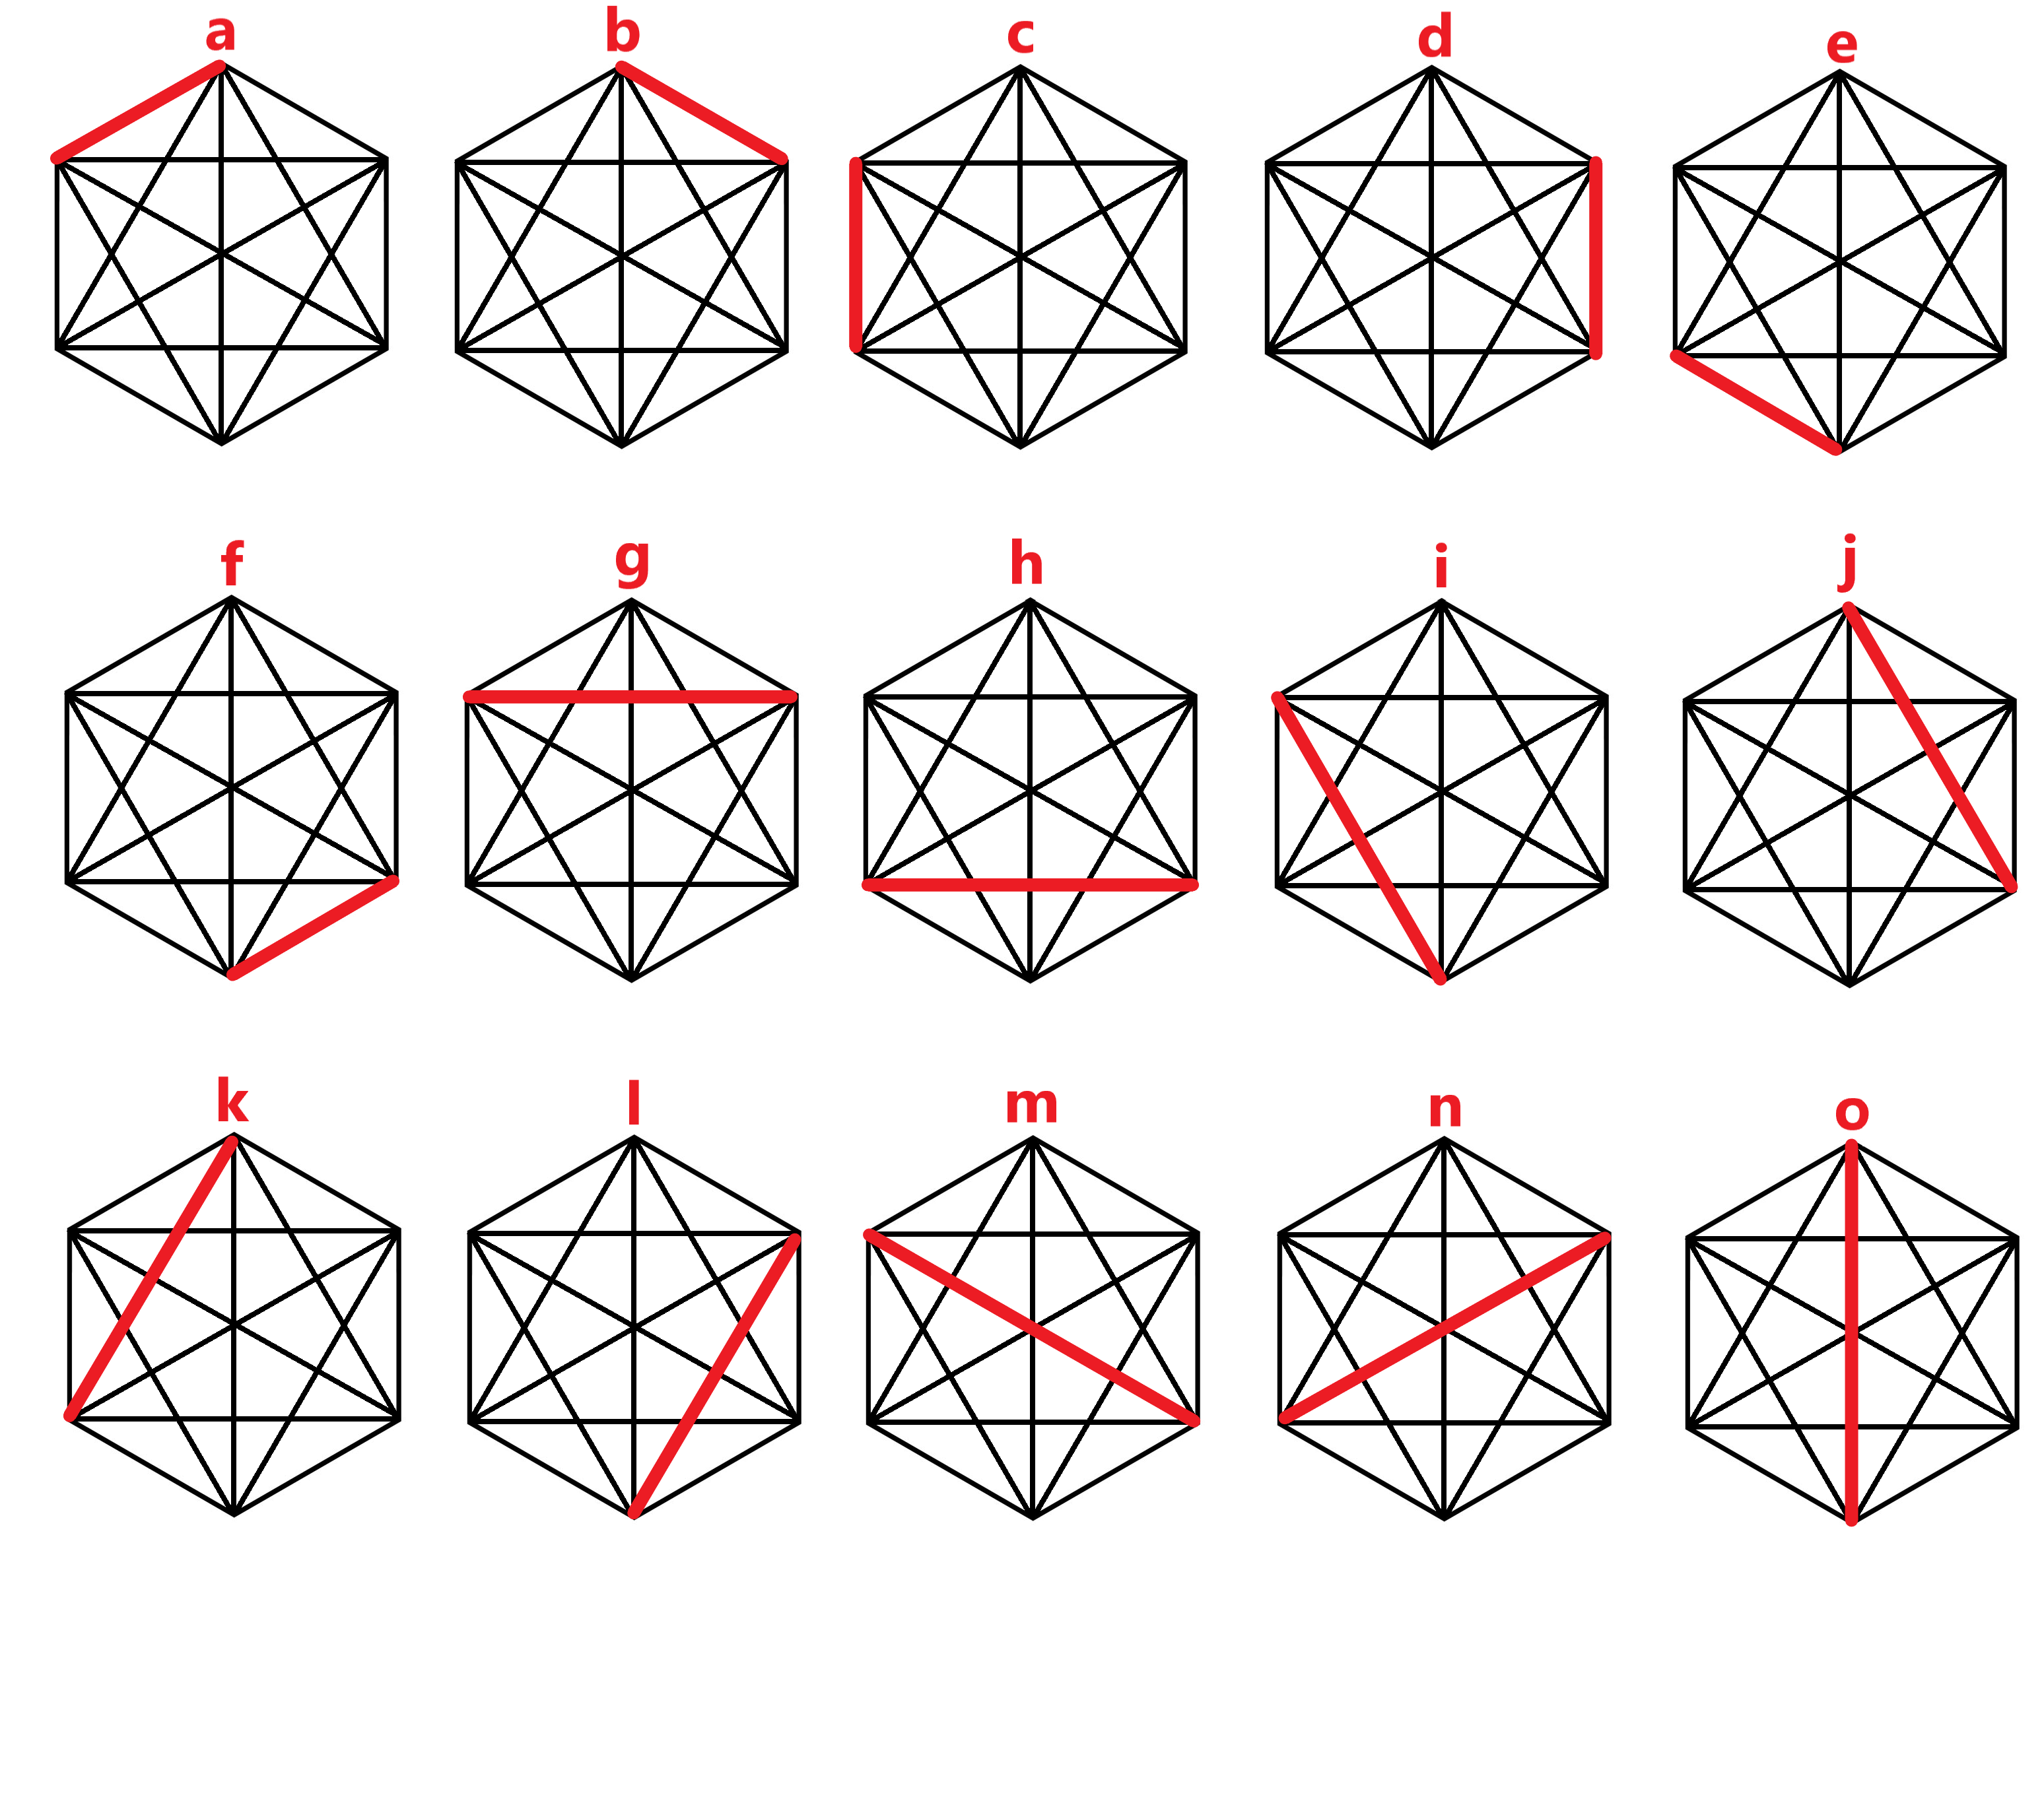

Slide 4
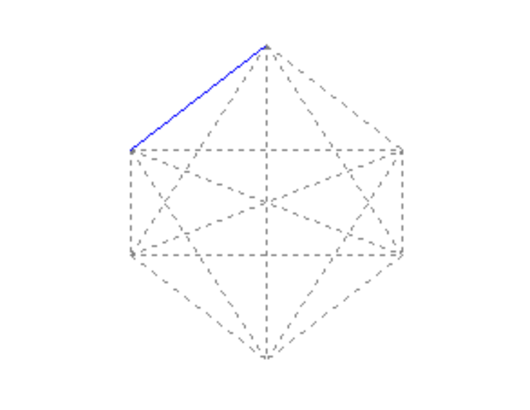
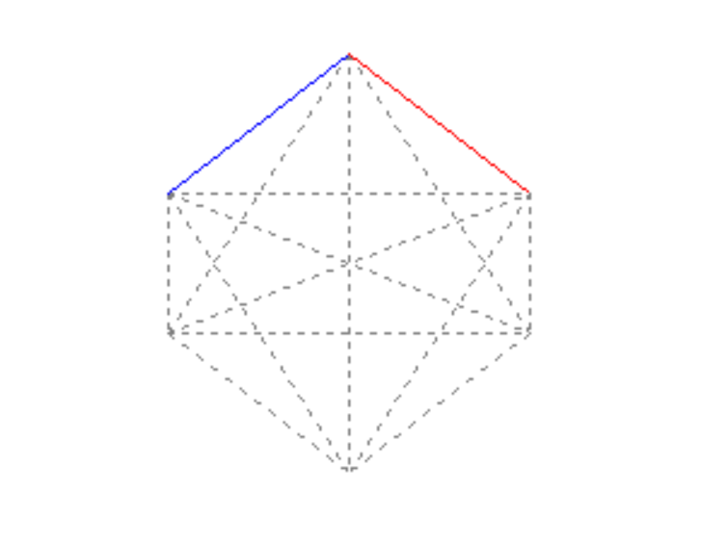
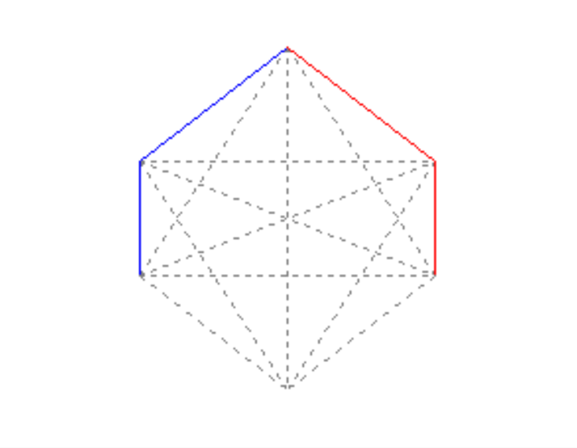

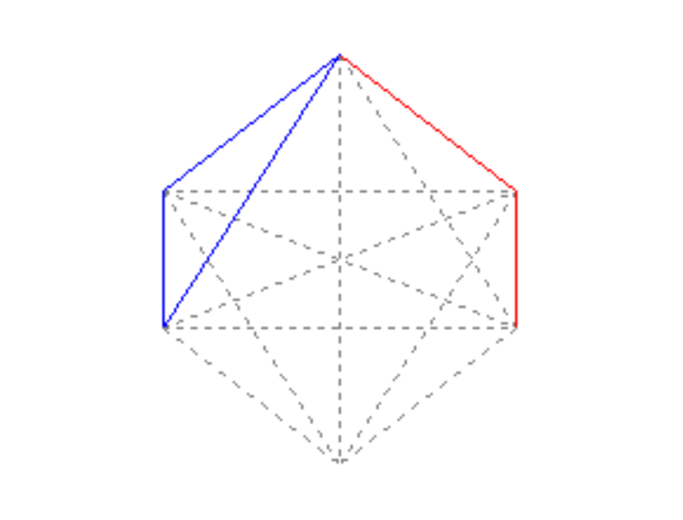
GAMEPLAY EXAMPLE
a
b
c
d
b
YOU LOST!
k

Slide 5
COLLECTIVE LEARNING
Reward/Punish
Initialization: divide probability equally among available lines
After the player first move, there are 14 available lines left: P₁ = 1/14
After the player second move, there are 13 available lines left: P₂ = 1/13
… so on

Slide 6
COLLECTIVE LEARNING (cont.)
Reward:
Double the probability of the lines that help the computer win
With the other lines that did not show up on the selection, decrease their probability by the same amount (as above) divided to the total number of available selections
Reward:
Halve the probability of the lines that make the computer lose
With the other lines that did not show up on the selection, increase their probability by the same amount divided to the total number of available selections

Slide 7
Tasks:
Hau Ha: Reward/Punish algorithm, testing
Minh Nguyen: Storing outputs into hash, GUI

